Slide 1
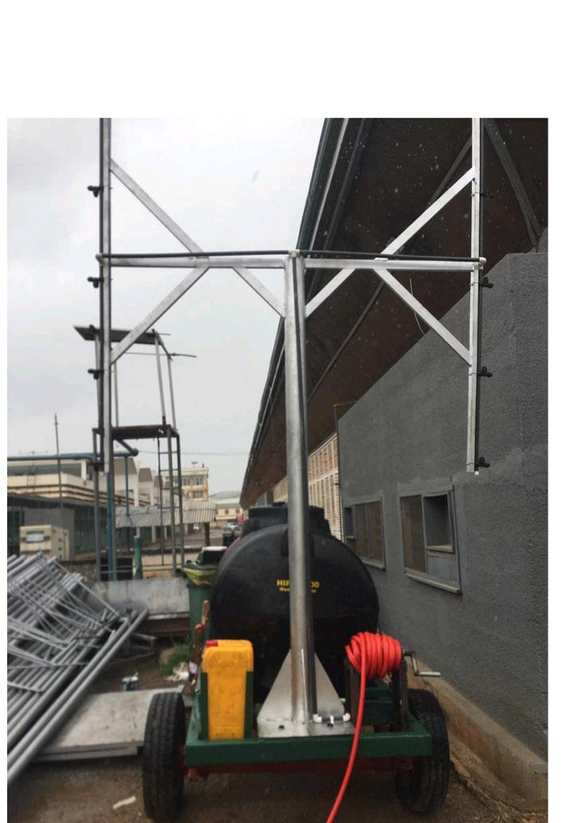
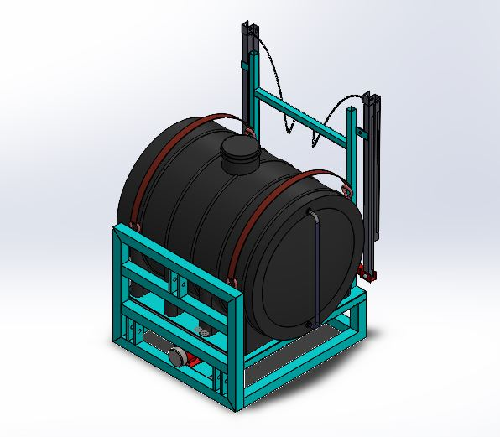
Redesign of a Tractor-trailer Sprayer Prototype
Presented by Alberta Petiafo

Slide 2
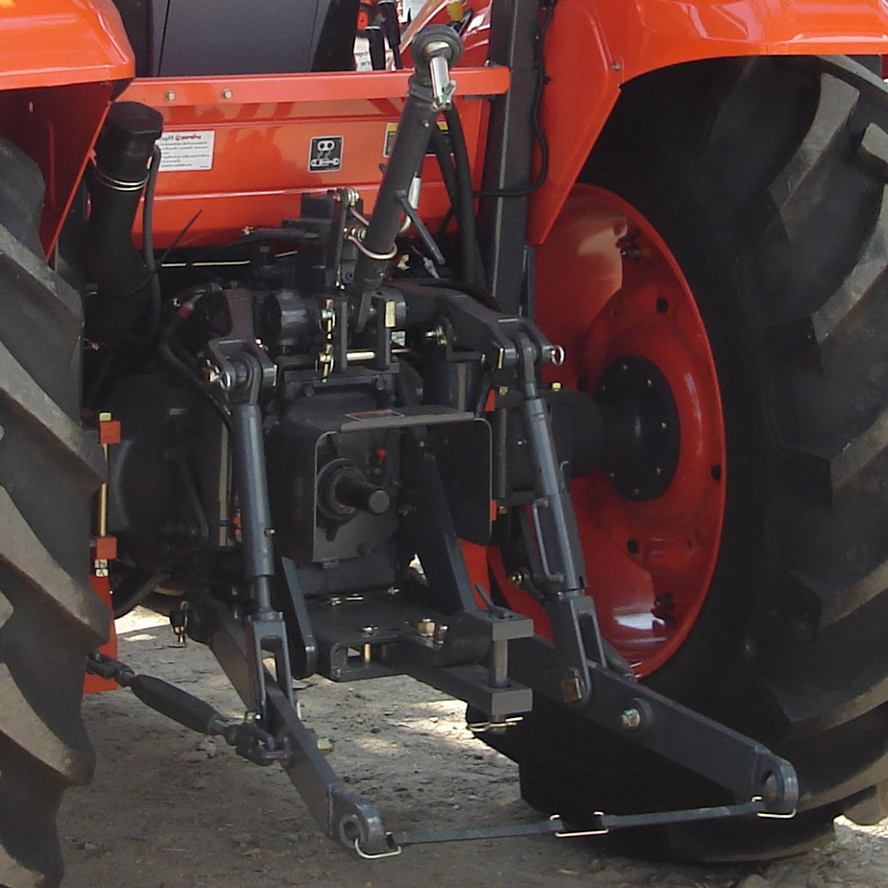
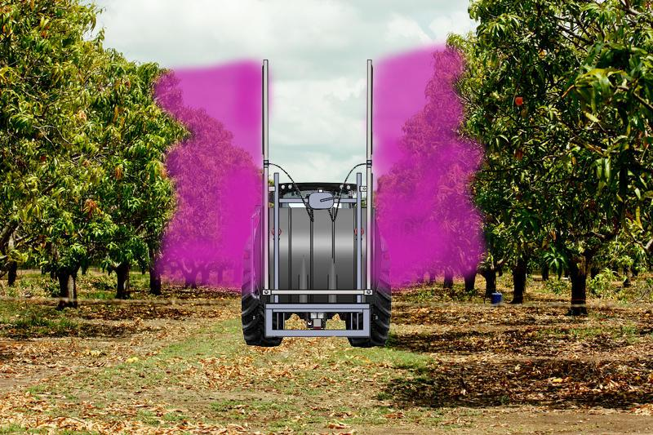

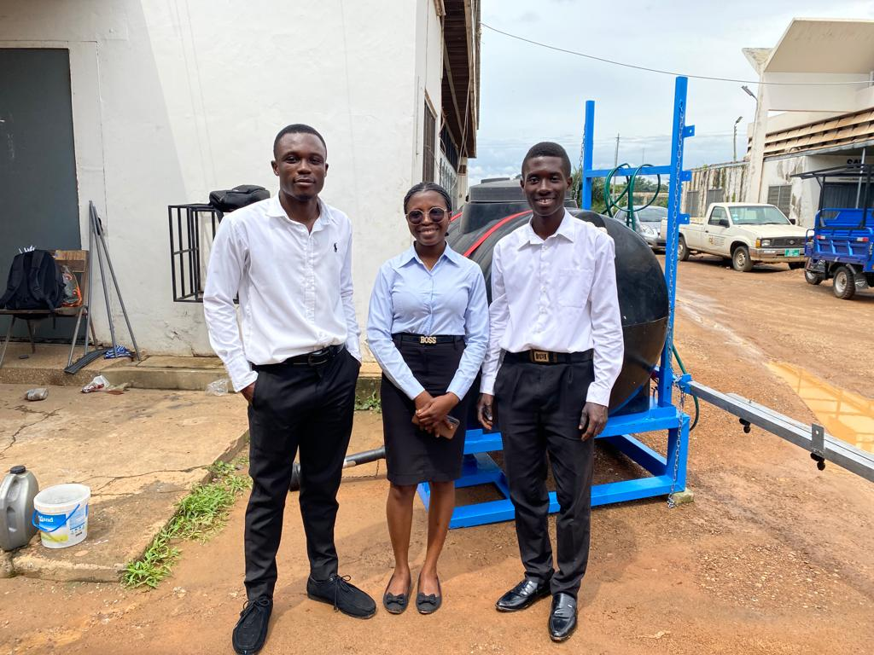
New Prototype
1
2
Vertical Spraying
Horizontal Spraying
3
SPRAYER
TEAM
Tractor with 3 point hitch

Slide 3
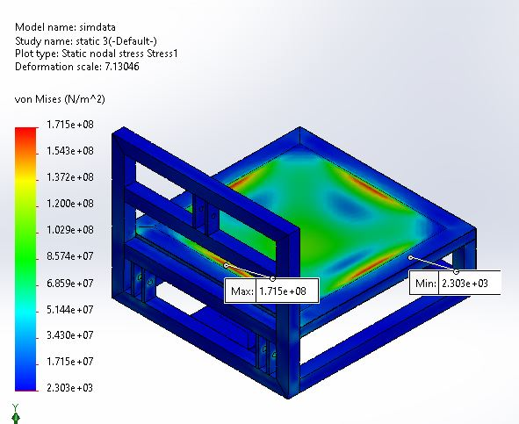
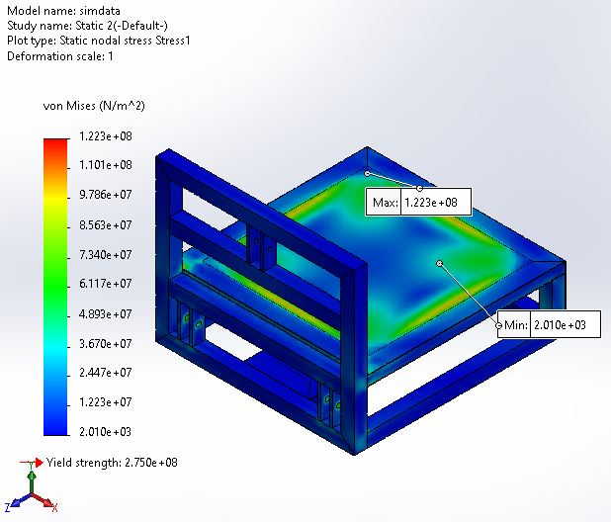
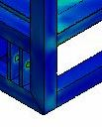
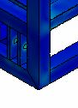
Frame Design and Simulations
Materials
Galvanized steel (ASTM A653 CS Type B)
Mild Steel ( AISI 1018)
Weight of water tank=1000 kg
The simulation was conducted with SN curve of the core material of the galvanized steel without considering the effects of coating integrity or hydrogen embrittlement.
Critical areas
Galvanised steel
σ_{y} = 275 MPa
Mild steel
σ_{y} = 370 MPa

Slide 4
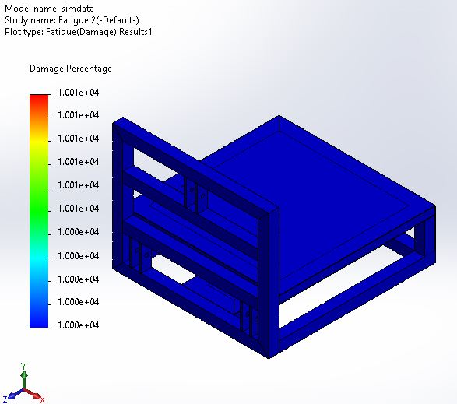
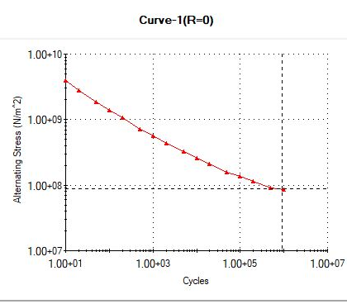
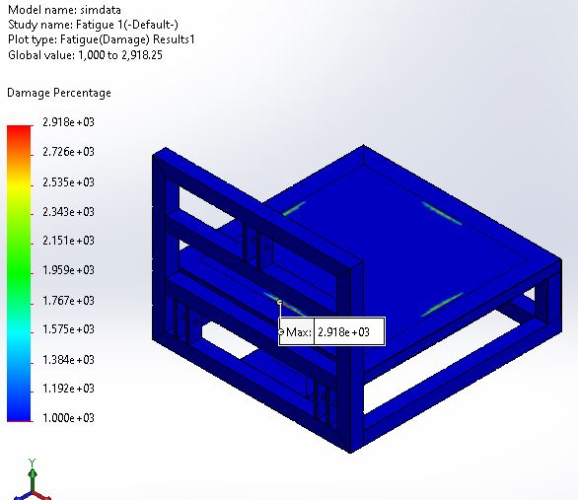
Fatigue Analysis of Materials
Max Stress=122 MPa
Cycles=3x10⁵
Strength/weight ratio = 724.4 Pa/kg
Galvanised Steel
G
M
Max Stress = 171 MPa
Cycle = 2x10⁵
Strength/weight ratio = 972.68 Pa/kg
S-N Curve for plain carbon steel
Mild Steel

Slide 5
Conclusion
Coating and Welding Integrity
Environmental Factors (Zn Reaction during corrosion)
Hydrogen Embrittlement
Strength to Weight Ratio
Recommendation
Further experiments need to be made to obtain a better SN curve on the fatigue behavioral
Sprayer height adjustability to different angles

